Slide 1
End-of-Year
Marketing Report
The Sinclair Verde Lamp Company

Slide 2
Agenda
1. | The goal
2. | End of year overview
3. | Holiday season report
4. | Conclusion
5. | Next steps

Slide 3
The Goal
This section summarizes the desired outcome the marketing agency set out to accomplish.

Slide 4
The Goal
The three primary marketing goals for the Sinclair Verde Lamp Company are:
Create brand awareness
Drive visits to the physical store
Increase online holiday sales by 3%

Slide 5
End-of-Year Overview
This section will give a review of the marketing trends presented in the analytics report.

Slide 6
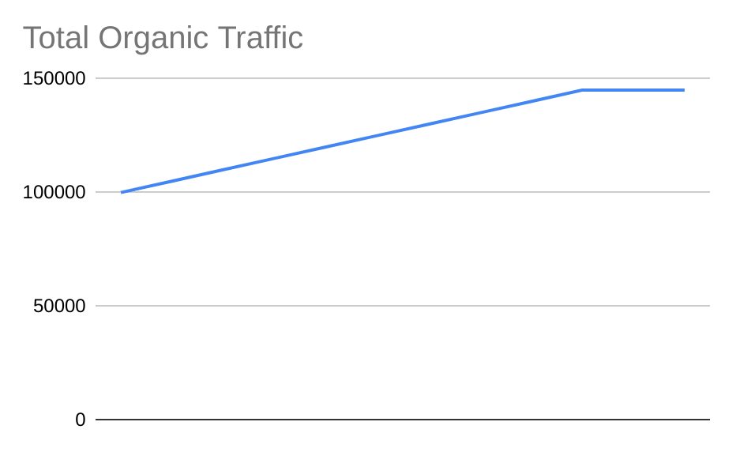
Organic traffic
In 2021, we experienced an overall increase organic traffic to the Sinclair Verde website.
In January, we started with 120000 organic searches.
We ended December with 170000 organic searches.
This is up 17.24% from last year.

Slide 7
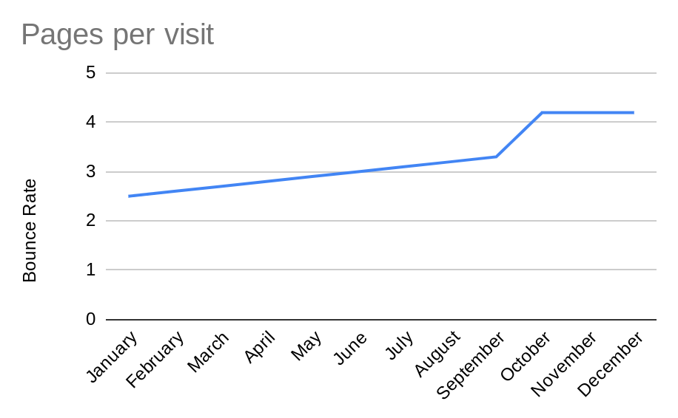

Slide 8
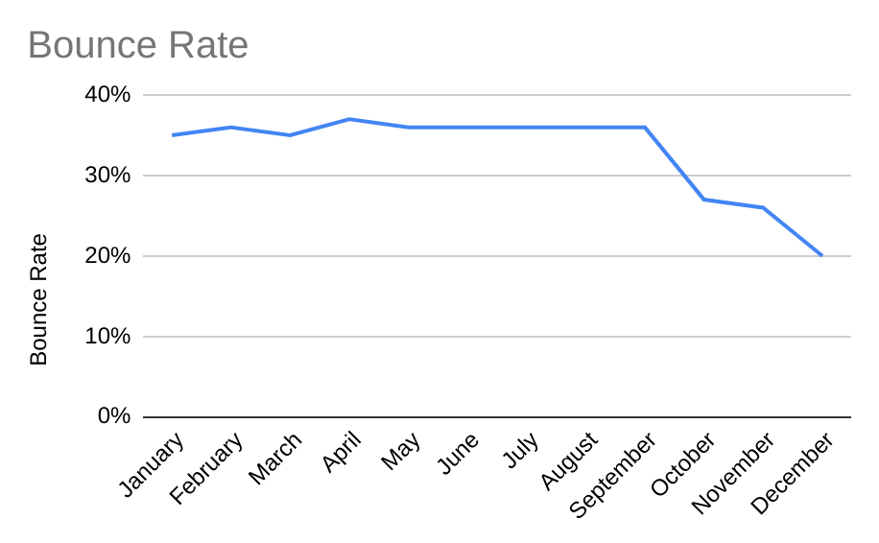

Slide 9
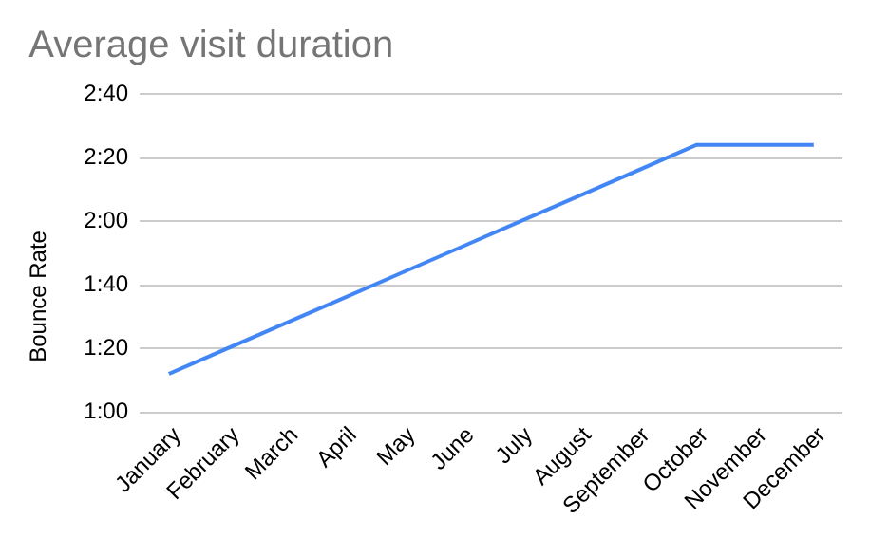

Slide 10
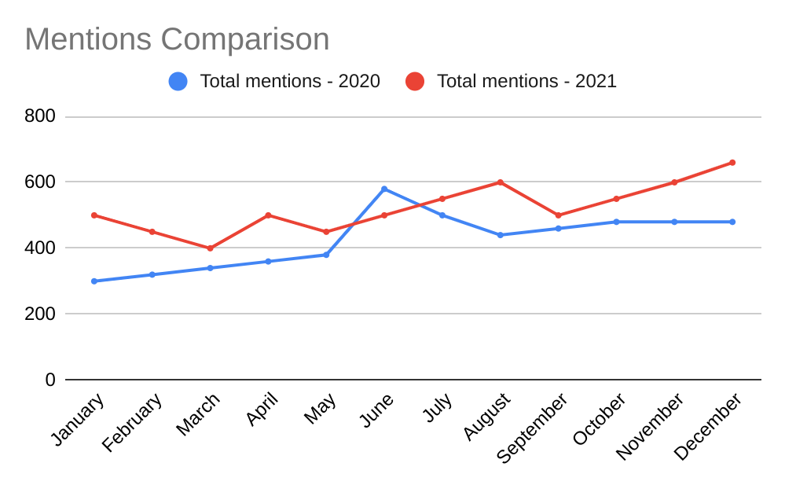
Social media mentions
In January, there were 500 social media mentions.
In December, there were 660 mentions.

Slide 11
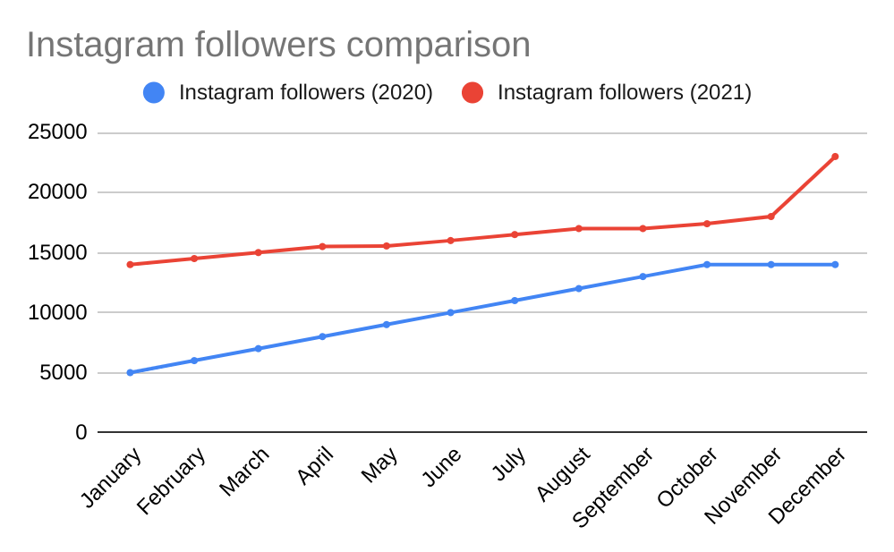
Instagram followers
Followers also increased. In 2021, the Sinclair Verde social media page gained 9000 followers.

Slide 12
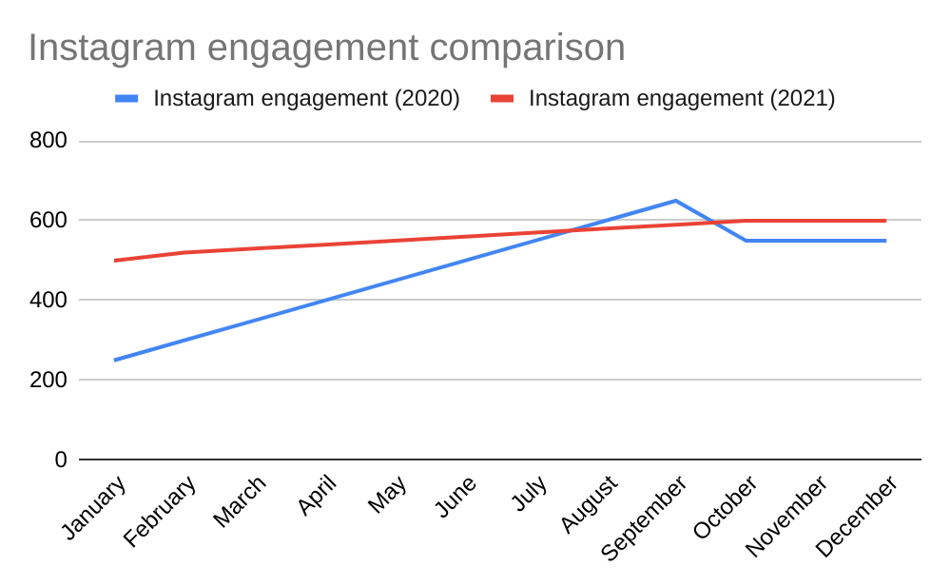
Instagram engagement
In January, there were 500 Instagram enegagements.
In December, there were 600 Instagram enegagements.

Slide 13
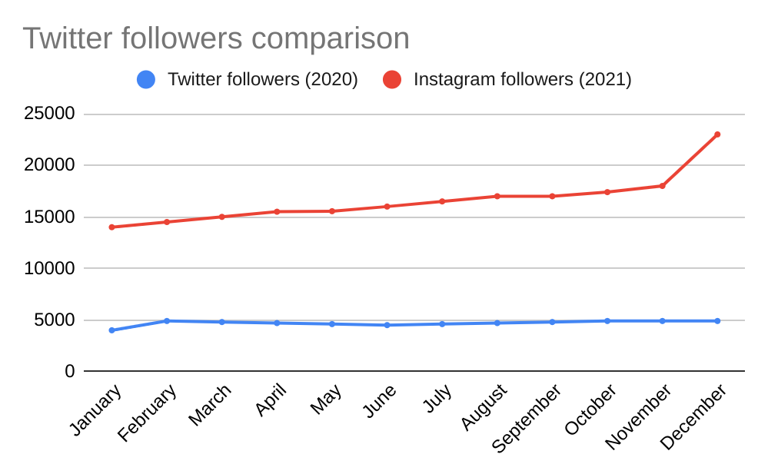
Twitter followers
In January 2020, there were 4000 Twitter followers.
In December 2021, there were 6800 Twitter followers.

Slide 14
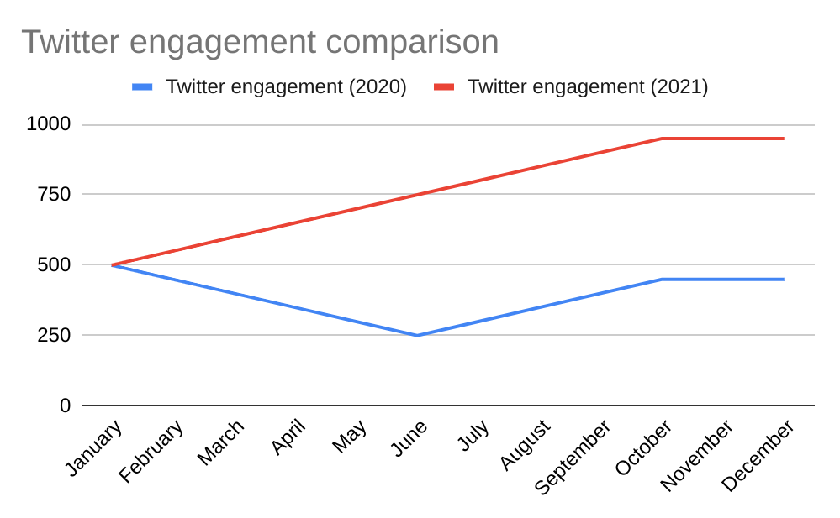
Twitter engagement
In January 2021, there were 500 Twitter engagements.
In December, there were 950 Twitter engagements.

Slide 15
Holiday Season Report
This section summarizes the data presented in the analytics report, specifically focusing on the months of November and December.

Slide 16
Organic Performance
 | November (Month 11) | December (Month 12) | Net Growth:
2020 Holiday Season | 145000 | 145000 | 0.00%
2021 Holiday Season | 165000 | 170000 | 3.03%

Slide 17
Conclusion
In this section, we will summarize the overall success of the campaign and make predictions about the upcoming year.

Slide 18
Conclusion
In conclusion, the overall marketing data suggests that we are achieving our desired goals. Sinclair Verde Lamp Company's organic performance and social media traffic is trending upwards.
With these upward trends, we'll continue to build on what we did in the past year. Any new ideas can build upon the momentum we've built on our previous work.

